Slide 1
Adroit System for Online Time Table and Announcement
Tİmur ATİLA 201311006
Özlem KILIÇ 201311030
Hatİce Nazlı KUŞ 201311037
Utku KILAVUZ 201411031
Advisor: Dr. Instructor Abdül Kadİr GÖRÜR

Slide 2
Adroit System For Online Time Table And Announcement
Updating the schedule actively
Display sudden announcements without losing time.
Interaction between students and teachers.
Preventing paper waste.

Slide 3

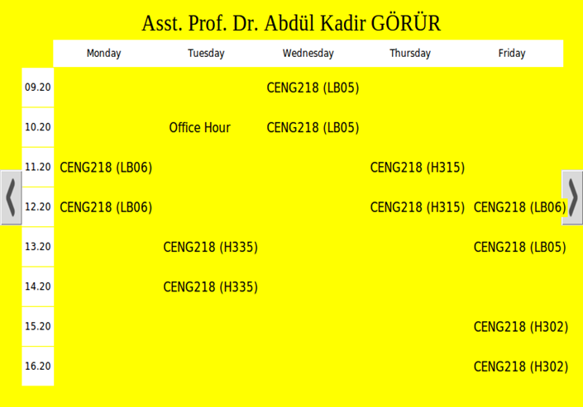
Main Features of Touchscreen
Checking the timetable of the teacher
Sending a message to the teacher
Navigate between the menus by using the touch screen
Checking the announcements listed by the teacher

Slide 4
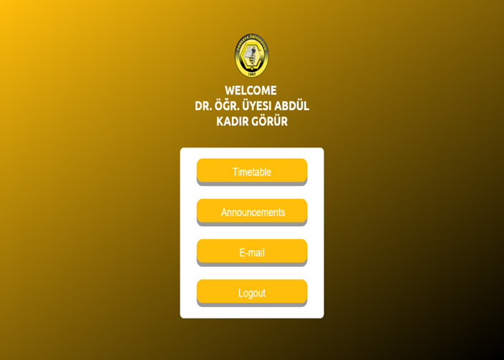
Main Features of Website (Teachers)
Editing the current time table (adding and deleting)
Replying the received messages
Publishing and editing an announcement

Slide 5
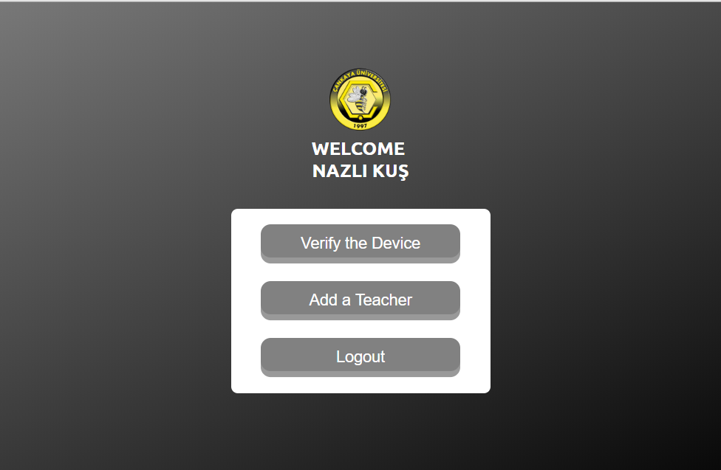
Main Features of Website (Admins)
Verifying a new device
Matching a teacher with a device

Slide 6
Main Features of Mobile Application
Editing the current time table (adding and deleting)
Replying the received messages
Publishing and editing an announcement

Slide 7
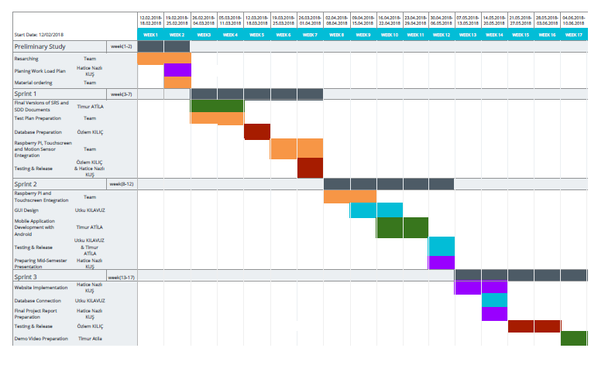
Work Plan

Slide 8
Success Criterion
Success Criterion | How to Measure
Increase in communication between teachers and students. | Survey
Decrease in time of announcements reaching to students. | Comparing the average time before and after the project.
Easier updating of timetable. | Survey

Slide 9






Technologies Used
Raspberry Pi
Touchscreen
Motion Sensor
Pi Camera
Programming Languages
Python
ASP.NET & C#
Java
MySQL

Slide 10
Acknowledgements
We would like to thank to
Dr. Instructor Abdül Kadir Görür
Dr. Instructor Murat Saran
Lecturer Efe Çiftci
Lecturer Ulaş Güleç

Slide 11
Thank You for Listening!
Any Questions?

